Slide 1
A
RESEARCH PROPOSAL
ON THE TOPIC:
DRINKING WATER QUALITY, SANITATION AND HYGIENE IN SELECTED PRIMARY SCHOOLS IN AKWA IBOM STATE, NIGERIA.
WRITTEN BY
JEREMIAH, ANIEBIET THOMPSON
21/PG/AG/EHM/003
SUBMITTED TO
CENTER FOR WETLANDS, ENVIRONMENTAL HEALTH AND WASTE MANAGEMENT
FACULTY OF AGRICULTURE
UNIVERSITY OF UYO
AKWA IBOM STATE
JANAURY, 2023

Slide 2
Background of the Study
Water is the most essential commodity for life sustainability and a satisfactory water supply must be available to the human population (WHO, 2011; Biswas, 2014).
According to Nickson, (2005), one-third of the world’s population rely on groundwater for drinking and other domestic purposes.
Unfortunately, the supply of safe drinking water has been compromised by the absence of adequate sanitary infrastructure, where this vital resource is vulnerable to pollution by both natural and anthropogenic activities such as natural geochemical processes, urbanization, industrial development, and agricultural activities (Rahman and Hashem, 2019; Idriss et al., 2020).
In children under the age of five, one third of all disease is caused by the environmental factors such as; unsafe water and air pollution (WHO, 2010).

Slide 3
Background of the Study
The poor state of food and water sanitation in the country has been shown to play a significant role in the etiology of food and water borne diseases (WHO, 2012).
National records showed that every year, about six hundred thousand (600,000) episodes of diarrhoea occur in children under the age of five which are school children and almost 50 percent of a child being underweight has a direct link to diarrhea (Alabi, 2010).
Some studies (Anunonwu, 2009; Bak et al., 2015; Okon, 2017) reported that drinking water contamination by coliform bacteria significantly increased the occurrence of various water-borne diseases including diarrhea, dysentery, typhoid, and hepatitis A and B. water quantity is as important as water quality.
Therefore, it is mandatory to access the quality of drinking water using bacteriological tests, especially the presence of coliforms bacteria in water.

Slide 4
Problem Statement
A major concern for human health is to drink safe water, especially for growing children because they are more vulnerable to hazardous microbial contamination in drinking water (Dangour et al., 2013).
Children who suffer a water-related ill-ness, with poor health remain in a disadvantaged position, reduces learning abilities, and indirectly affect schooling through absenteeism may result in attention deficits and early dropout (Islam et al., 2013).
It has also been recorded that 1.5–2 million children die each year from water quality and sanitation-related diseases and many more are weakened by illness, pain, and discomfort (Tarrass and Benjelloun, 2007).
School-aged children spend too many hours in and around school facilities, as a result, close monitoring is necessary to improve the school environment.
So, schools are a high-risk environment for children and hence, the need to ensure a safe water supply from a reliable source.

Slide 5
Justification of the study
According to the World Health Organization (WHO, 2017), access to safe drinking water can result in tangible benefits to health.
Safety of the water supply is key to public health, especially for children, who generally require greater protection. School children can spend five to six hours a day in primary schools in Nigeria.
In this sense, it is essential that this communal space presents favourable environmental conditions to ensure good health practices and quality of life for children as they are the most vulnerable to poor water quality.
The acronym WASH indicates solutions for addressing the emergence and spread of diseases, which includes all-around water use, sanitation, and hygiene.
Consequently, wide-ranging actions are required to solve Environmental Sanitation problems in order to reduce and avert their adverse health, economic and developmental effects.

Slide 6
MATERIALS AND METHODS
Study Area
The study will be conducted in selected primary schools in Abak, Uyo and Oruk Anam Local Government Area of Akwa Ibom State, Nigeria.
The first school selected for this study will be Government Primary School, Obio Akpa, Oruk Anam Local Government Area, Akwa Ibom State.
The second school selected for this study will be St. Patrick Primary School, Iboko Offot, Uyo located in Uyo local Government Area, Akwa Ibom State, Nigeria.
Annang People School, Utu Abak will be considered the third site for this study.

Slide 7
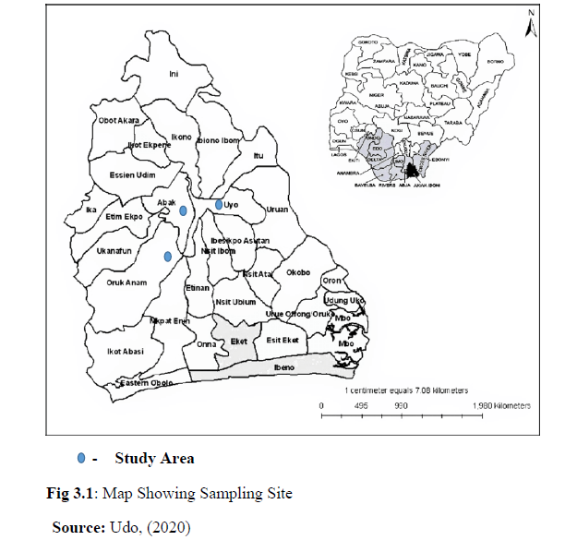

Slide 8
Sample Collection and Preparation
The study design is cross-sectional, which aimed at finding out the pH and EC, Fe, As, Cl⁻ content, microbial load and the health risk associated with the drinking water in these areas. Drinking water samples will be collected twice: once in each month of February (dry season) and May (wet season) from the selected schools located in different parts of Akwa Ibom State as earlier discussed in the study area description. A total of 3 (three) drinking water samples will be collected from the 3 representative schools in Uyo, Abak, Oruk Anam Local Government Area of Akwa Ibom State. The sample volume collected will be 500 ml. Each sample will be partition into five samples.
Water Analyses
The drinking water samples from the schools will be analyzed in Akwa Ibom State Ministry of Science and Technology Laboratory for physicochemical parameters (pH, electrical conductivity, As, Fe and Cl elements determination) and microbiological characteristics (total coliform, E. coli and heterotrophic bacteria).
Physiochemical Analyses
The water pH and electrical conductivity (EC) will be determined on-site using digital pH meter and EC meter, respectively.
Microbiological Analysis
Fecal coliform (FC) and total coliform (TC) bacteria will be examined using the membrane filtration method (APHA 2012).

Slide 9

Public Health, Hygiene and Sanitation Condition of Schools
Observations on public health and safety facilities and drinking water and sanitation facilities in the selected schools will be made by providing a checklist questionnaire sheet as shown in Appendix1. All the data from schools will be tabulated and analyzed.
Health records of primary Health Care centers within the selected school area will also be collected to afford possible comparison with water quality from schools.
Health Risk Assessment
The As risk in drinking water for children consumers at primary schools will be evaluated in term of non-carcinogenic exposure through ingestion and dermal pathways, known as hazard quotient (HQ) using Equation (1) (Proshad et al. 2017).
where, RfD is the oral toxicity reference value (R_{f}D ingestion for As 3.04 x 10⁻⁴ mg/L/day, R_{f}D dermal for As 1.23 x 10⁻⁴ mg/L/day.

Slide 10


The average daily intake (ADI) in mg/L/day will be calculated using Equation (2) (Proshad et al. 2017);
where, C_{water} indicates As concentration in a sample of water (mg/L), IRwater is the water ingestion rate (1.6 L/day for children), EF is the exposure frequency (365 days/year), ED is the exposure duration (12 years for children), AT is the average age time (4,830 days for children), and BW is the body weight (30 kg for children). Notably, this will act as a guide to our conclusion;
If the HQ is <1, no adverse health effects are expected as a result of exposure.
If the HQ>1, adverse health effects are possible (USEPA. 2011).
The target carcinogenic risks (CR) derived from the intake of As will be calculated using Equation (3) (Proshad, 2017);
where, SF is the oral slope factor. The oral slope factor (SF) for As is 1.5 mg/L/day. In order to estimate carcinogenic risk, it will be suggested that people in the study area are dependent on groundwater for their drinking and other domestic purposes.

Slide 11
Data Analysis
Multivariate statistical analysis methods in terms of the Pearson’s correlation analysis and the principal component analysis (PCA) will be applied to evaluate the inter-relationship among water quality parameters and interpret the potential sources of contaminants. Statistical analyses will be carried out using the statistical package SPSS 24.0 (SPSS, USA).

Slide 12
QUESTIONAIRE USED FOR THE RESEARCH
SECTION A: Basic School Related Information
Please fill as appropriate
Location of the school………………………………………………………
Type of school ownership……………………………………………………..
Education Level of the school ………………………………………………..
Numbers of Students ……………………………………………………….
Numbers of Teachers ……………………………………………………….

Slide 13
SECTION B: Basic Sanitation Questions
S/N | Basic Sanitation Questions | Ratings
1 | Are there handwashing facilities at school ? | No – 0 Yes - 1
2 | What is the type of toilet available? | No toilet latrine – 0 Flush - 1 Pit latrine with slab - 2 Pit latrine without a slab -3
3 | How many toilets are usable at the time of survey ? | 1-5
4 | Are there separation toilets for males and females (boys and girls)? | No – 0 Yes - 1
5 | Are there soap and water at the toilets or it's premises? | No – 0 Yes - 1
6 | How are the toilets? | Clean - 1 Somewhat clean - 2 Not Clean - 3
7 | Are there separation of toilets for staff and students? | No – 0 Yes - 1
8 | Number of persons per toilet | 25 persons/toilet - 1 40 persons / toilet - 2 >40 persons/ toilet -3
9 | Are toilets covered from the side ? | No – 0 Yes - 1
10 | Are the toilets covered from the roof ? | No – 0 Yes - 1
11 | What is the nature of the school compound? | Clean - 1 Not clean - 2
12 | Are there visible excreta (feces) in the premises? | No – 0 Yes - 1
13 | Is there anybody defecating in the field at the time of the survey? | No – 0 Yes - 1

Slide 14
THANK YOU!!

